Slide 1
Object Detection using Convolution Neural Network
RCNN

Slide 2
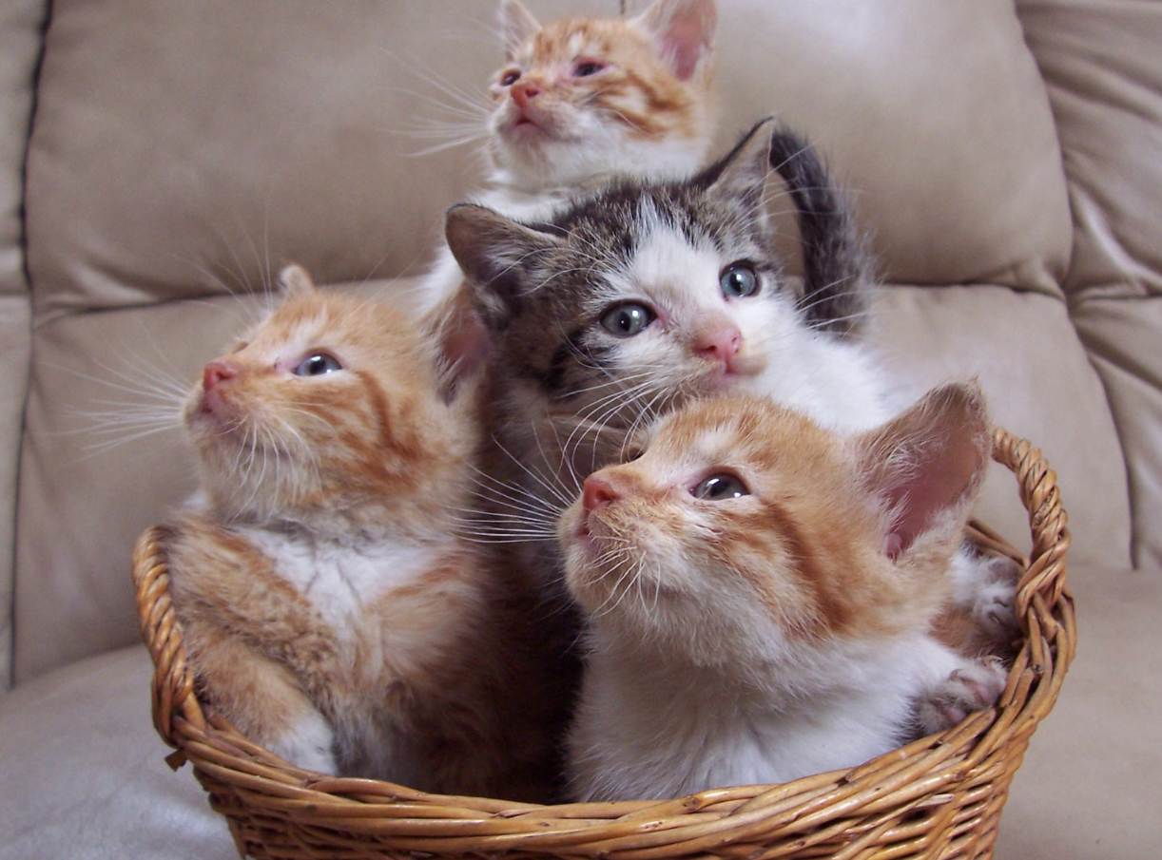
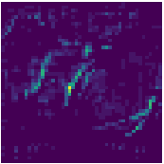
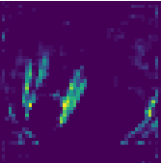
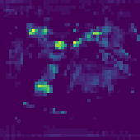

Overfeat - Summary
Idea 4
Sliding window (spatial output ) + Pretrained Model + Image Pyramid + FC as convnet
Testing
FC as convnet
FC1
Regression
MODEL
FC2
VGG 16
Sliding window
+
Image Pyramid
Feature Extraction
Classification
Pre Trained Localize Model

Slide 3
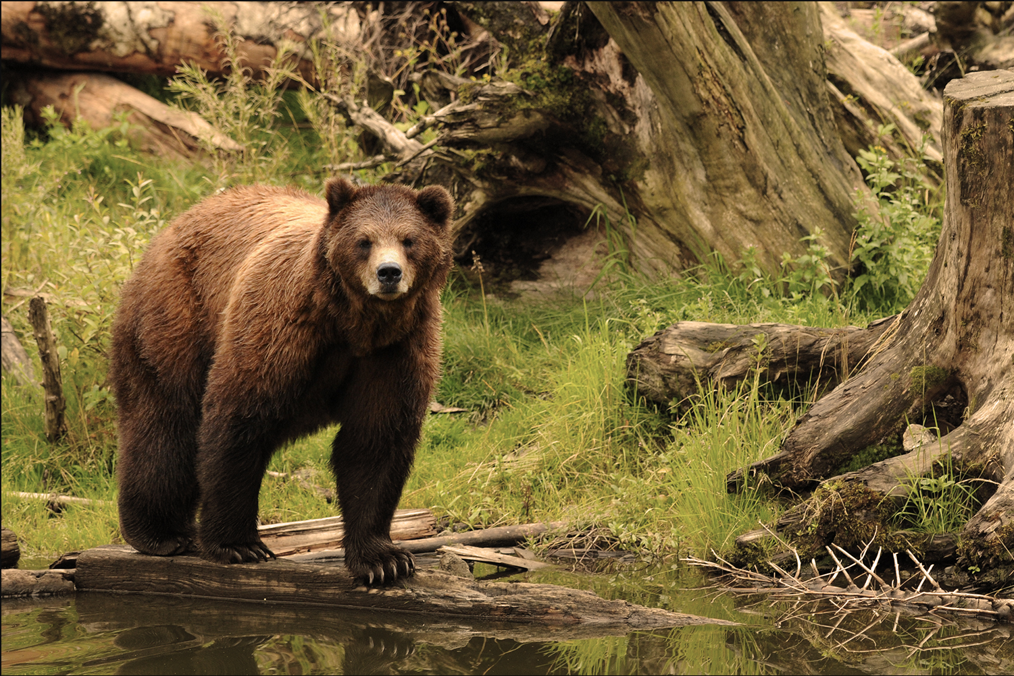
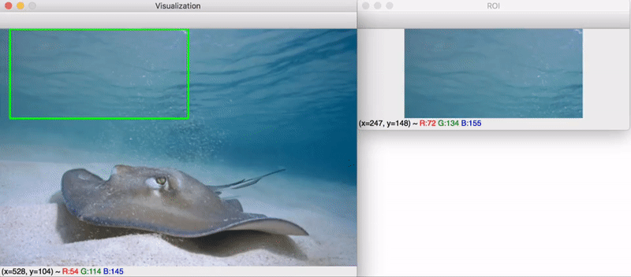
Overfeat - Drawbacks
Unnecessary processing all the background regions.
Computationally Inefficient.
Sliding window approach creates a lot of FP , therefore less MAP
If we somehow get only those regions where any object is present, isn’t that would be awesome ?
What?
We only want regions where there is high probability of having an object.
Not necessary we want to know the class label of that object.
Speed of Region Proposals generation should be faster.
Will it improve the accuracy of detection (MAP).
Credit :https://www.pyimagesearch.com/2020/06/29/opencv-selective-search-for-object-detection/

Slide 4
Follow up Contents
Classical Approaches for Region Proposals
Density of Edges
Super pixel straddling
EdgeBoxes
Selective Search
RCNN – Region Based Approach
Results and Failure Cases of RCNN
CNN + Classical Based Region Proposal Paradigm

Slide 5


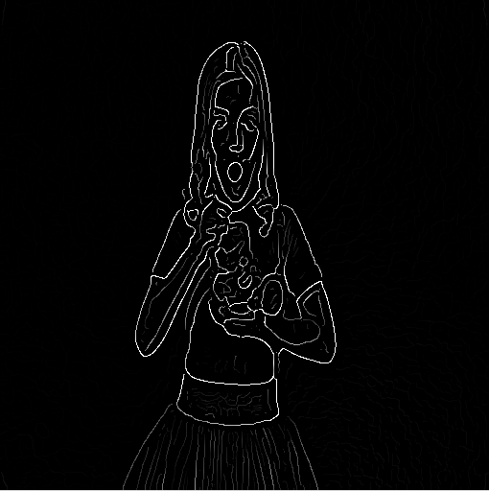
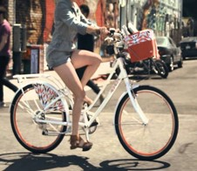
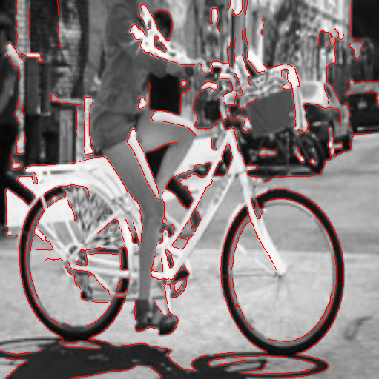
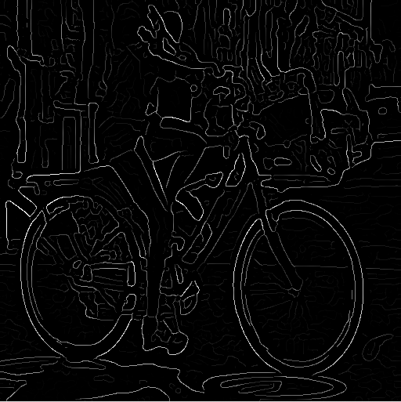
Approaches for Generating Region Proposals / Candidates
Idea 1
Density of Edges
Example 1
Example 2

Slide 6
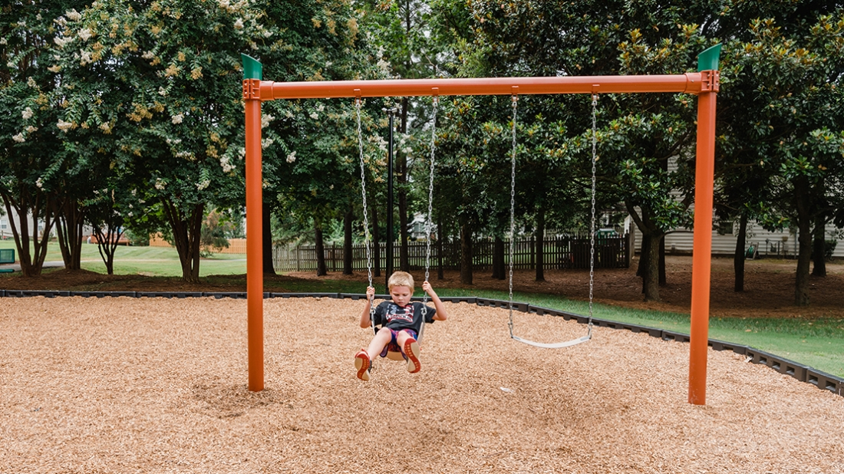
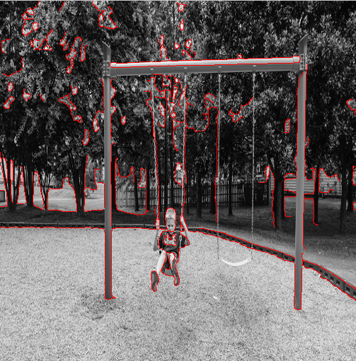
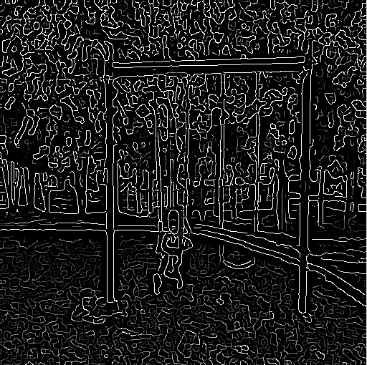
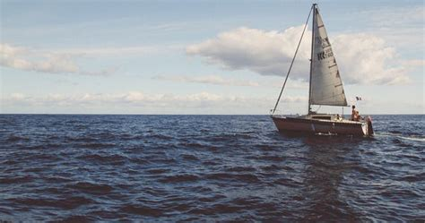
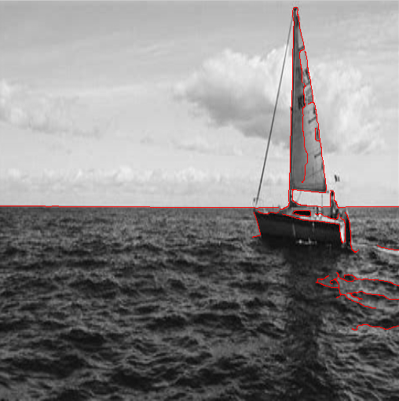
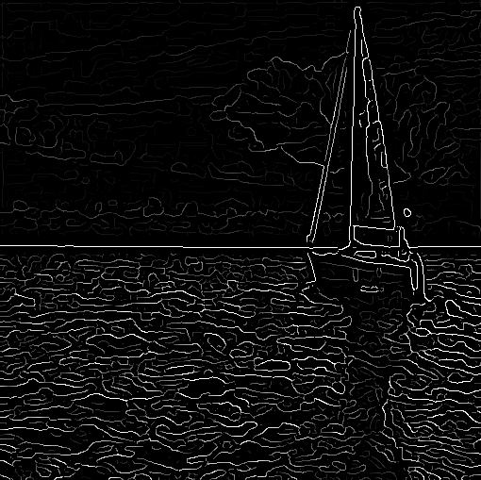
Approaches for Generating Region Proposals / Candidates
Idea 1
Density of Edges
Example 3
Example 4

Slide 7
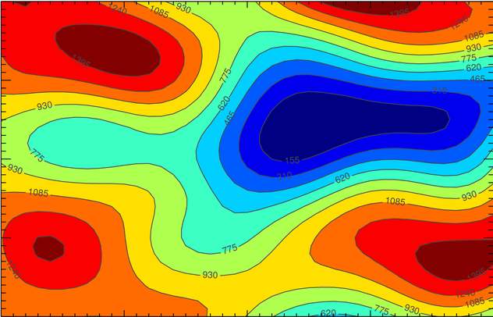
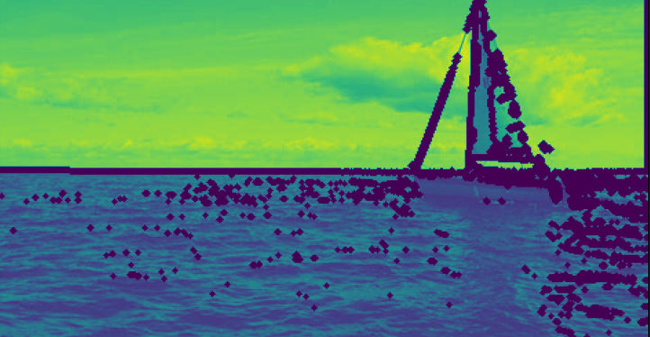
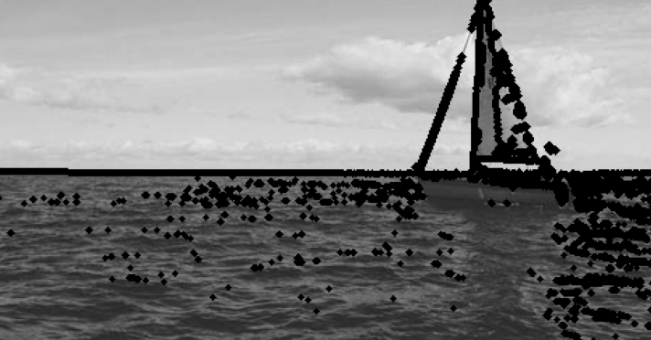
Approaches for Generating Region Proposals / Candidates
Idea 2
Edge Boxes
Density of Edges
Contour Plot
How we create Contour ?
Edge Boxes

Slide 8
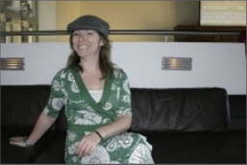
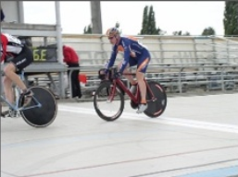
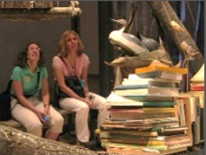
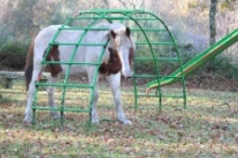
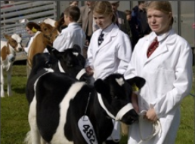
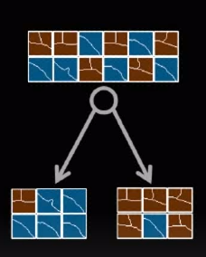
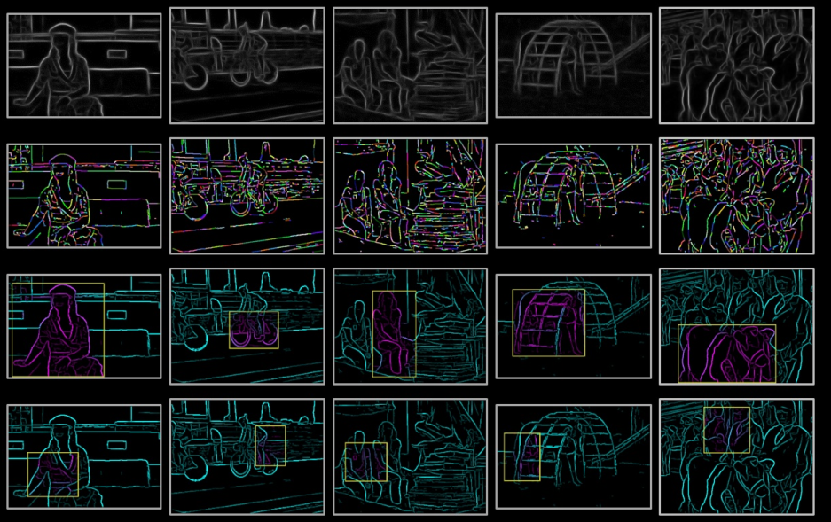
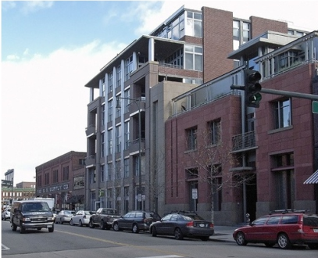
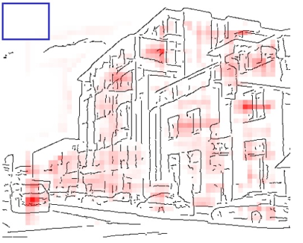
Approaches for Generating Region Proposals / Candidates
Idea 2
Edge Boxes
Density of Contours
Use Random Forest to combine similar Edges
Q. How to decide good or bad region proposals ?
Source: Edge Boxes: Locating Object Proposals from Edges

Slide 9
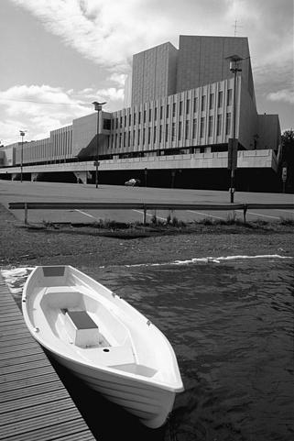
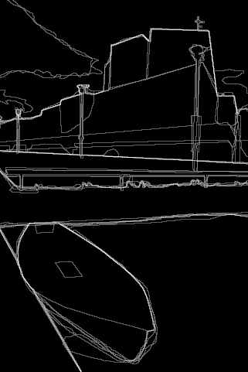

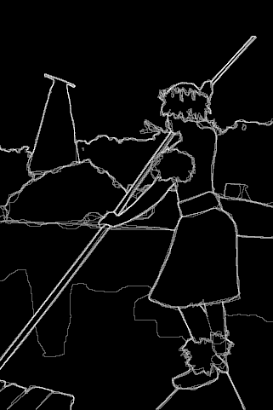
Approaches for Generating Region Proposals / Candidates
Idea 2
Edge Boxes
Why we are using sliding window, If we wanted to avoid using it in first place ?
No training is happening here.
Are we sure that these boxes contain objects?
No, just high probability of having some object.
Does Edge Boxes Algorithm knows what is the class name of object present inside region proposals ?
No
Is it faster ? Why ?
Yes, Hand Crafted algorithm and no training
Results

Slide 10

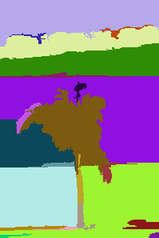
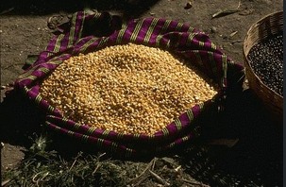
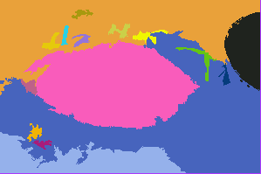
Approaches for Generating Region Proposals / Candidates
Idea 3
Super pixel Straddling
Idea of Super Pixel Straddling
1 | 4 | 2 | 69 | 84 | 91 | 93 | 112
5 | 7 | 9 | 64 | 81 | 82 | 95 | 156
6 | 2 | 3 | 53 | 83 | 91 | 92 | 180
66 | 55 | 59 | 54 | 51 | 72 | 48 | 192
62 | 58 | 56 | 55 | 69 | 73 | 49 | 165
61 | 63 | 66 | 69 | 69 | 52 | 50 | 190
156 | 159 | 165 | 146 | 135 | 146 | 156 | 159
179 | 187 | 199 | 158 | 138 | 173 | 156 | 163
Example 1
Example 2
Combine pixels having closer color intensity.
Combine closer regions.
Credit: Efficient Graph-Based Image Segmentation

Slide 11
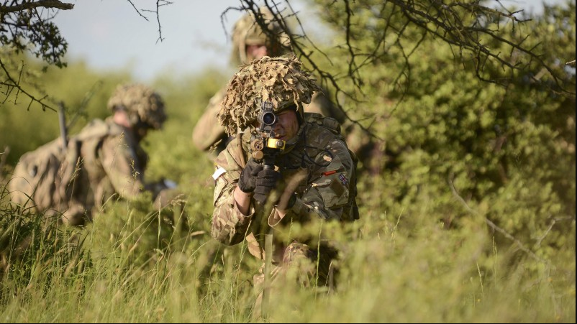
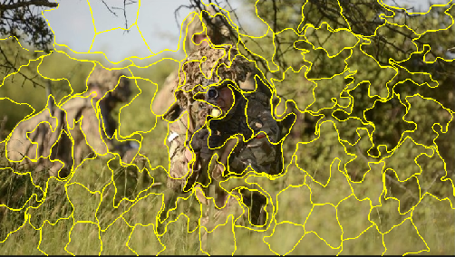
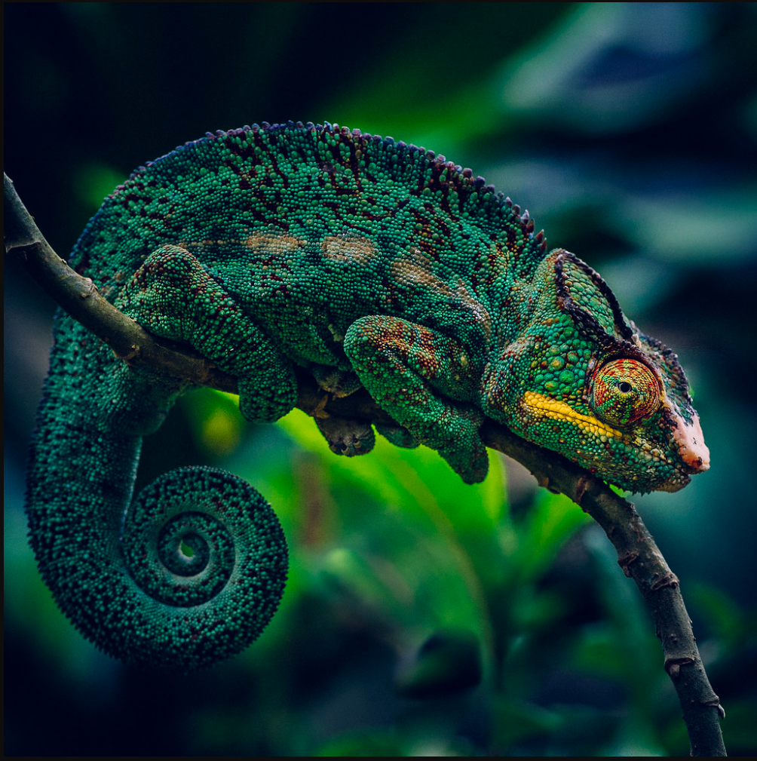
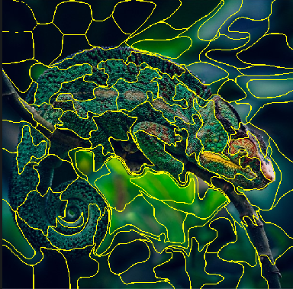
Approaches for Generating Region Proposals / Candidates
Idea 3
Super pixel Straddling
Example 3
Example 4
Code: https://www.pyimagesearch.com/2014/07/28/a-slic-superpixel-tutorial-using-python/

Slide 12
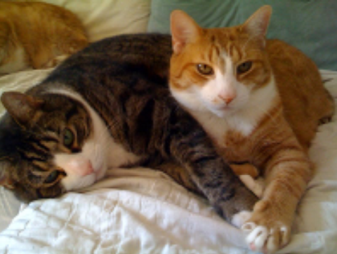
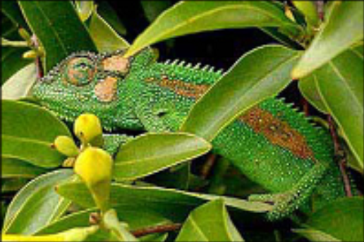
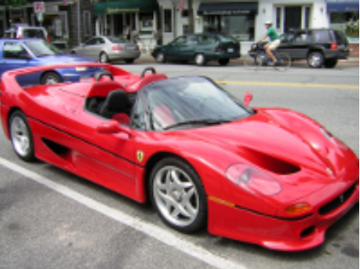
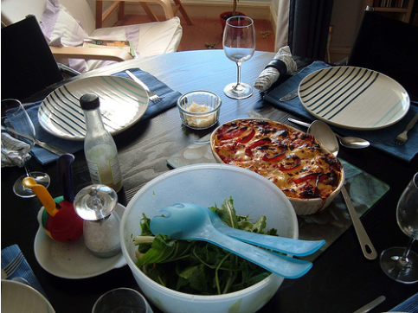
Approaches for Generating Region Proposals / Candidates
Idea 4
Selective Search
Problems of merging superpixels
Distinguished by Color
Distinguished by Texture
Distinguished by Composition
Distinguished by Hierarchy
There is no single scale or single way by which we propose a region or segment out a region.

Slide 13
Approaches for Generating Region Proposals / Candidates
Idea 4
Selective Search
Selective Search merges superpixels in a hierarchical fashion based on five key similarity measures:
Color similarity – Merging regions based on similar color intensity
Texture similarity – Merging regions based on similar texture
Size similarity – Smaller regions be grouped earlier rather than later.
Shape similarity/compatibility – Combine composite regions.
A final meta-similarity measure - A final meta-similarity acts as a linear combination of the color similarity, texture similarity, size similarity, and shape similarity/compatibility.
Distinguished by Color
Distinguished by Texture
Distinguished by Composition
Distinguished by Hierarchy
Credit: https://www.pyimagesearch.com/2020/06/29/opencv-selective-search-for-object-detection/

Slide 14
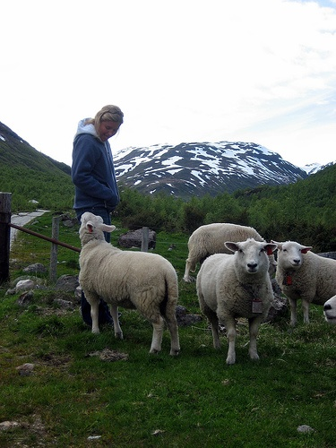
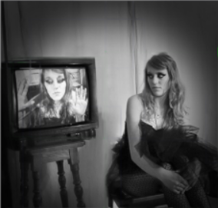
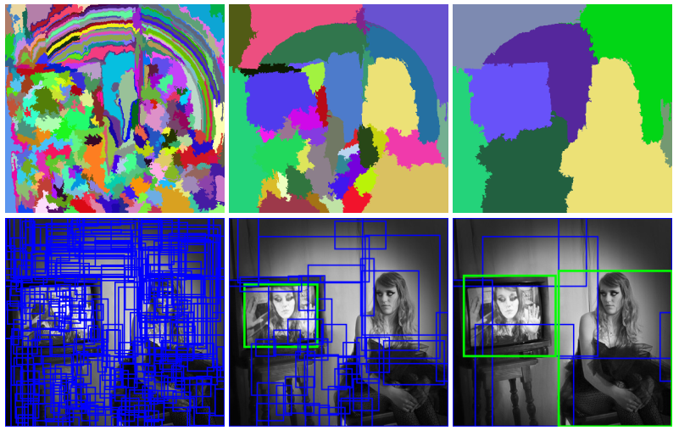
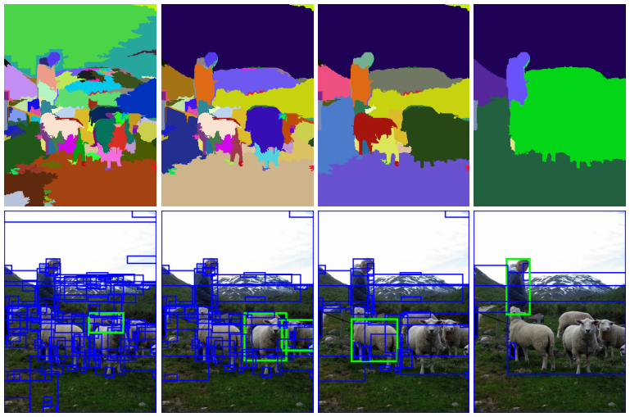
Approaches for Generating Region Proposals / Candidates
Idea 4
Selective Search
Example 1
Example 2
After Initial
Segmentation
After Few Iteration
After many Iteration
After Initial
Segmentation
After Few Iteration
After Few More Iteration
After many Iteration
Source: https://www.koen.me/research/pub/vandesande-iccv2011.pdf

Slide 15
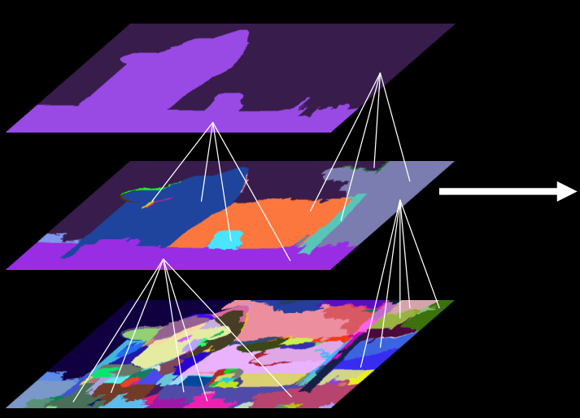
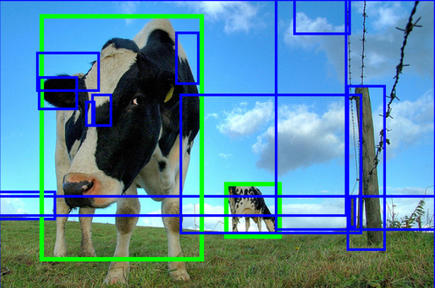
Approaches for Generating Region Proposals / Candidates
Idea 4
Selective Search
Given a image perform Selective Search Segmentation based on 5 similarity measures.
Propose multiple Region Proposals.
Small scale proposals help to find smaller objects. (Bottom Layer)
Large scale proposals might help to recognize larger object. (Top Layer)
Source: https://www.koen.me/research/pub/vandesande-iccv2011.pdf

Slide 16
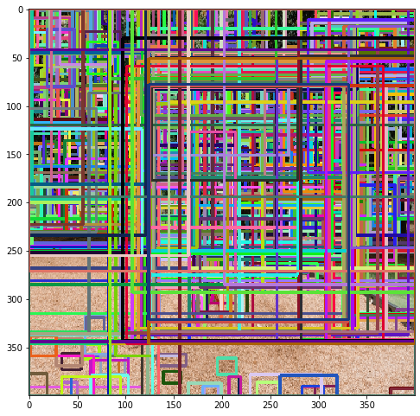
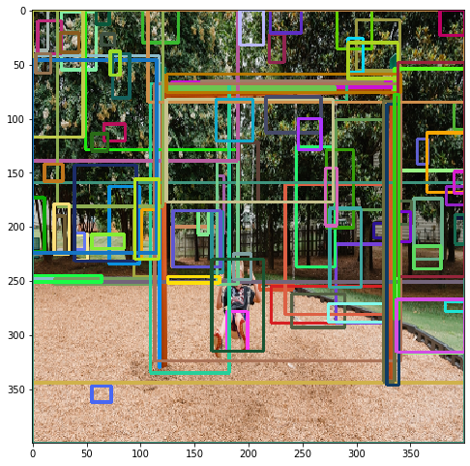






Approaches for Generating Region Proposals / Candidates
Idea 4
Selective Search
Code: https://www.pyimagesearch.com/2020/06/29/opencv-selective-search-for-object-detection/

Slide 17

Approaches for Generating Region Proposals / Candidates
Top Classical Approaches
Source: How good are detection proposals, really? – J. Hosang

Slide 18
Object Detection – RCNN – Region Proposal Based CNN
Classification and Localization Model
224 X 224
FC1
Fc2
Regression
C + 1 Class
MODEL
Region Proposals
Alex Net
Fc1
Fc2
Feature Extraction
Classification
Score Using
SOFTMAX
Pre Trained on ImageNet
SS / EB
~ 2 K
Proposals
224 X 294
Cropped
Regions

Slide 19
Object Detection – RCNN – Region Proposal Based CNN
Classification Model
227 X 227
FC1
Fc2
Regression
C + 1 Class
MODEL
Region Proposals
Alex Net
Fc1
Fc2
Feature Extraction
Classification
Score Using
SOFTMAX
Pre Trained on ImageNet
SS / EB
227 X 227
~ 2 K
Proposals
Regions
Warping
No Special output – No FC as Convnets – No Image Pyramid
No Regression Training

Slide 20
Object Detection – RCNN – Region Proposal Based CNN
Classification Model
227 X 227
NMS
PER CLASS
C + 1 Class
Person or Not
Car or Not
-
-
-
-
-
Dog or Not
MODEL
Region Proposals
Alex Net
Fc1
Classification
Score Using
Linear SVM per class
Fc2
Feature Extraction
Pre Trained on ImageNet
SS / EB
227 X 227
~ 2 K
Proposals
Regions
Warping
No Special output – No FC as Convnets – No Image Pyramid
No Regression Training
C – Class # of SVM Linear classifier (One V Rest)

Slide 21

Object Detection – RCNN – Region Proposal Based CNN
Stage 1
Classical CV
Stage 2
CNN
Classification Model
Fc1
Fine Tuning on Region Proposals using log loss [SOFTMAX]
(Training Only)
Fc2
C + 1 Class
RCNN
44 %
54 %
Fc1
Classification
Score Using
Linear SVM per class
RCNN + FT
Region Proposals
MODEL
Fc2
Alex Net
Feature Extraction
SS / EB
Pre Trained on ImageNet
~ 2 K
Proposals
Localize model is trained on Image Net has learnt different general property of each objects. Warping Image to fixed size Distorts that property therefore Finetuning the model using SoftMax increase the performance.
Cropping +
Warping

Slide 22
Object Detection – RCNN – Region Proposal Based CNN
Stage 1
Classical CV
Stage 2
CNN
Classification and Localization Model
Fc1
Fine Tuning on Region Proposals using log loss [SOFTMAX]
(Training Only)
Fc2
C + 1 Class
RCNN
44 %
54 %
58 %
Fc1
Classification
Score Using
Linear SVM per class
RCNN + FT
Region Proposals
MODEL
Fc2
Alex Net
RCNN + FT + BB
Feature Extraction
Fc1
Bbox Regression
SS / EB
Pre Trained on ImageNet
~ 2 K
Proposals
Localize model is trained on Image Net has learnt different general property of each objects. Warping Image to fixed size Distorts that property therefore Finetuning the model using SoftMax increase the performance.
Adding Bbox Regressor increase the performance. Need only minute adjustment, therefore only one layer for Bbox Regressor.
Cropping +
Warping

Slide 23
Object Detection – RCNN – Region Proposal Based CNN
Stage 1
Classical CV
Stage 2
CNN
Classification and Localization Model
Fc1
Fine Tuning on Region Proposals using log loss [SOFTMAX]
(Training Only)
Fc2
C + 1 Class
RCNN
44 %
54 %
58 %
66 %
Fc1
Classification
Score Using
Linear SVM per class
RCNN + FT
Region Proposals
MODEL
Fc2
VGG 16
RCNN + FT + BB
RCNN + FT + BB + VGG16
Feature Extraction
Fc1
Bbox Regression
SS / EB
Pre Trained on ImageNet
~ 2 K
Proposals
Localize model is trained on Image Net has learnt different general property of each objects. Warping Image to fixed size Distorts that property therefore Finetuning the model using SoftMax increase the performance.
Adding Bbox Regressor increase the performance and reduces the mis localization. Need only minute adjustment, therefore only one layer for Bbox Regressor.
Alex Net to VGG16 further increased the performance.
Cropping +
Warping

Slide 24


Object Detection – RCNN – Region Proposal Based CNN
~ 2013

Slide 25
Object Detection – RCNN – Region Proposal Based CNN - Training
Stage 1
Classical CV
Stage 2
CNN
Part 1
Classification and Localization Model
Fc1
Fine Tuning on Region Proposals using log loss [SOFTMAX]
(Training Only)
Fc2
C + 1 Class
Part 2
Fc1
Classification
Score Using
Linear SVM per class
Region Proposals
MODEL
Fc2
VGG 16
Training
+
Testing
Feature Extraction
Fc1
Part 3
Bbox Regression
SS / EB
Pre Trained on ImageNet
~ 2 K
Proposals
Cropping +
Warping

Slide 26
Object Detection – RCNN – Region Proposal Based CNN - Testing
Stage 1
Classical CV
Stage 2
CNN
Classification and Localization Model
C + 1 Class
Part 2
Fc1
Classification
Score Using
Linear SVM per class
Region Proposals
MODEL
Fc2
VGG 16
Testing
Feature Extraction
Fc1
Part 3
Bbox Regression
SS / EB
Pre Trained on ImageNet
~ 2 K
Proposals
Cropping +
Warping

Slide 27




Object Detection – RCNN – Region Proposal Based CNN – Testing – Paper
Bbox Reg
Convnets
Warped Images
SVMs
Bbox Reg
Apply Bbox Regression and Linear SVM per class to classify objects
Region of Interest (ROI) from proposal methods
( ~ 2k )
Convnets
SVMs
Warped Images
Bbox Reg
Convnets
SVMs
NMS
per class
Cropping
+
Warping
1. Query Input
2. Extract Region Proposals ( ~ 2k )
3. Compute CNN Features
4. Classify Regions
Paper: Rich feature hierarchies for accurate object detection and semantic segmentation - 2013

Slide 28









Object Detection – RCNN – Region Proposal Based CNN – Results
~ 2013
IOU >= 0.5
VOC 2012 Dataset
Source: https://arxiv.org/abs/1311.2524

Slide 29

Object Detection – RCNN – Curiosity Questions
Why not required Sliding window or Image Pyramid or Special outputs ?
We itself started the discussion to avoid these constrains.
Sliding window for image location.
Image pyramid for various size objects
Selective Search solves all these issues
Why RCNN is giving higher performance metric (accuracy) ?
Reduces the False Positive because only processing Regions and avoiding a lot of background to process.
Is Overfeat faster and training is End to end ?
RCNN takes 9 times more for each inference.
13 sec/image in GPU
53 sec/image in CPU
Why Multi Class linear SVM?
Selective Search gives us the Cropped Region Proposals
Region Proposal

Slide 30
Object Detection – RCNN – Drawbacks
Testing
Bbox Reg
Convnets
Warped Images
SVM
Bbox Reg
Region of Interest (ROI) from proposal methods
( ~ 2k )
Convnets
Apply Bbox Regression and SVM to classify objects
SVM
Warped Images
Bbox Reg
Convnets
SVM
Major Disadvantages
Advantages
Process 2,000 region proposals individually by CNN (Don’t share CNN computational resource).
Training is 2 Stage (Classical + CNN) and not End to End like Overfeat.
Inference time is much slower than Overfeat because of processing ~ 2k ROI proposals for each query image.
Selective Search is not trainable (hardcoded) and therefore not very good in generalizing.
More Accurate
Should we even follow up this approach? Is it even worth researching this approach? Where can RCNN be use?
Medical use cases
Any ways to improve RCNN ?

Slide 31
Two Paradigm of Object Detection
Paradigm
End to End Training
Dense sampling Based
Multi Stage Training
Region Proposal Based
(Overfeat)
(RCNN)
Which paradigm or approach will take over other ?
END ☺

